Slide 1
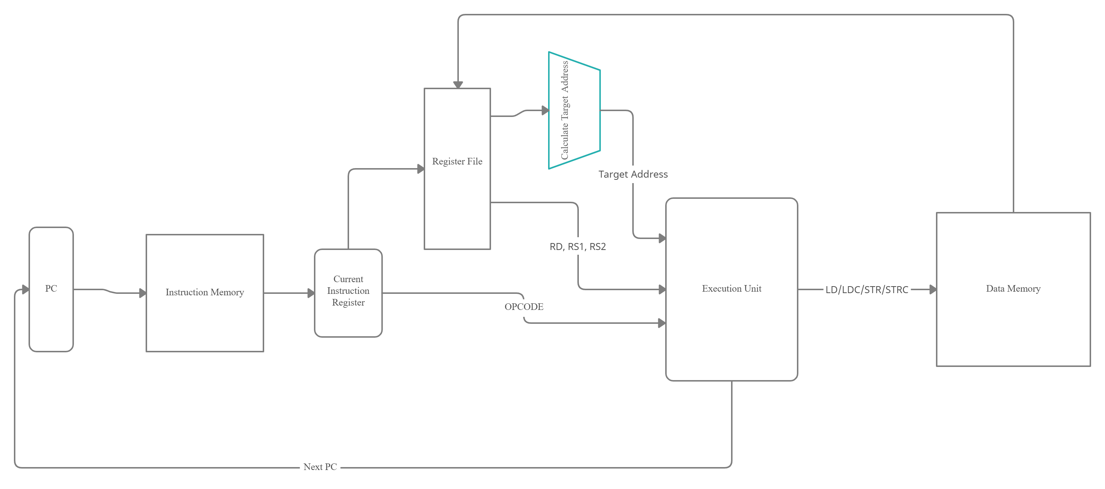
Scalar Processor Diagram

Slide 2
Planned Architectural Features
Pipeline to allow for ILP
Pipeline registers (between each pipeline stage)
Multiple Execution Units, With varying tasks for better ILP
Branch Prediction
Reservation Stations for OoO execution
ROB
Floating Point Support

Slide 3
Future Experiments
Show that implementing a single Pipeline reduces the number of cycles needed for execution of vector addition.
Show that expanding number of EUs reduces number of cycles further for vector addition
See that a 2-bit dynamic branch prediction has a miss rate of <10% on a quick sort of a list of 30 items
Show that branch prediction is within 10% performance (no. of cycles needed) of a unrolled vector addition loop
Use of Reservation stations reduces stalls by 25% for a recursive algorithm – factorial (lots multiplication and memory access so chance for stalls)
Changing from unified to grouped reservation station will reduce stalls by 25%
Using ROB with reservation station will minimise pipeline stalls and reduce total cycles

